Slide 1
INTRODUCTION TO BEST PRACTICES OF ESTIMATING
CITY OF ROCHESTER
UPSTATE NY MWBE CONFERENCE
THURSDAY, MARCH 23, 2023

Slide 2
Agenda
Introductions
Project Selection
Document Review
Plans
Specifications
Addenda
RFI
Front Ends
Communication
Pricing – Workshop
Proposal – Workshop
Post Bid Follow Up
Building Long Term Relationships
Questions & Answers
Notes:
Introductions
Project Selection
Document Review
Plans
Specifications
Addenda
RFI
Front Ends
Communication
Pricing – Workshop
Proposal – Workshop
Post Bid Follow Up
Building Long Term Relationships
Questions & Answers

Slide 3
INSTRUCTORS
Jenna Abato
Bill Rutan
Senior Estimator
Senior Estimator
585-487-7226
abatj@pikecs.com
585-241-0541
rutab@pikecs.com
Notes:
Bill Rutan has been with Pike for over 10 years, he began his career focusing on subcontractor solicitation and preconstruction budgeting. Bill currently works as a Senior Estimator. His responsibilities include leading projects estimates/preconstruction, review of design team’s estimates, value engineering and pricing options, and change order support. While not at work Bill serves as an Elder and Adult Sunday School teacher at his church, enjoys hiking and spending time with his wife and their 5 children.
(585) 241-0541
rutab@pikecs.com
Jenna Abato has over 10 years of experience focusing on preconstruction estimating and budgeting. Jenna currently takes ownership of estimating responsibilities for projects in education, commercial, retail and industrial market sectors, as well as design-build projects.
(585) 487-7226
abatj@pikecs.com

Slide 4
About Pike

Slide 5
Office Location
Northeast
WESTERN NEW YORK
Buffalo
740 Seneca Street
Buffalo, NY 14210
Tel: 1.800.264.PIKE
Rochester
1 Circle Street
Rochester, NY 14607
Tel: 1.800.264.PIKE
EASTERN NEW YORK
Capital District
20 Loudonville Road
Albany, NY 12204
Tel: 1.800.264.PIKE
CENTRAL NEW YORK
Utica
258 Genesee Street
6th Floor
Utica, NY 13502
Tel: 1.800.264.PIKE
Utica
110 Lomond Court
Utica, NY 13502
Tel: 1.800.264.PIKE
Southeast
CENTRAL FLORIDA
Orlando
5850 T.G. Lee Boulevard
Suite 135
Orlando, Florida 32822
Tel: 1.800.264.PIKE

Slide 6
Project Selection
Review ALL Contract Documents
Do you meet the qualification requirements?
Does the project schedule work for your schedule?
Are you able to staff the job properly?
Do you have the right certifications required?
Can you provide the proper warranty?
Competition? Chance of winning project
Project Location?
ARE YOU ABLE TO MAKE A PROFIT?

Slide 7
Document Review – Read, Read, Read
Plans
Other Documents
Plans
Read all the plans
Read all the notes
Coordination Issues within plans
Scaling – Changes from page to page; within a page
Addenda
RFI
Front Ends
Vendor Drawings
Reports
Environmental
Geotechnical
STC Engineering
Physicists
Specifications
Read All Applicable Specifications; Front Ends
Read the section when it states “As It Pertains To”

Slide 8
Communications with GC Prime Or Owner
Get on their bid invitation list
Make a face-to-face appointment with the prime
Introduction of Firm
When you are bidding work
Send your scope of work in 3 days before the bid to review
Voicemails, emails, etc
Follow Ups
During Bidding, After Bidding, For Future Work
Find the awarded GC and follow up with them
Reach out periodically for introductions – staff changes at GCs

Slide 9
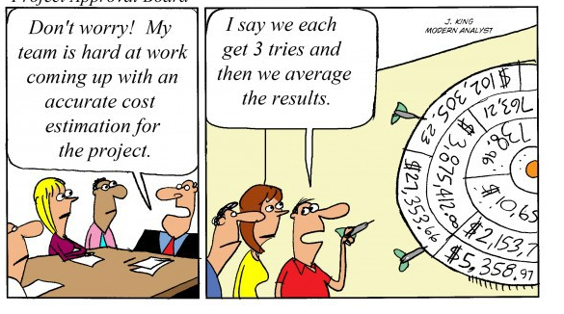
Pricing Workshop How Do You Come to a Number?
Example – 4 Doors – Furnish and Install
Labor – 1 Carpenter ($65/hr) – 4 hrs/door = $260 x 4 $1,040
Materials – 1 Door $1,500 x 4 $6,000
Subcontractor – Trucking - $500
Equipment – Small Tools $150
Total – Cost of Work $7,690
Indirect Costs
Fee – 8% $615
Insurance - 1.2% $92
Sub Total $8,397
Pricing Factors
Labor
Materials
Subcontractor
Equipment

Slide 10
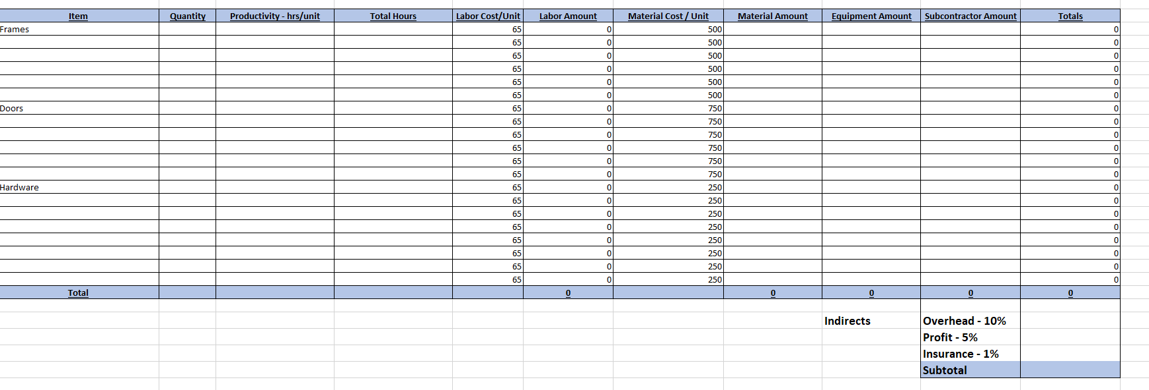
Pricing Workshop – Doors

Slide 11
Proposal Workshop
Review (2) Quotes – Look for positives and negatives of each deliverable – 5 minutes

Slide 12
Proposal Workshop

Slide 13
Proposal Workshop

Slide 14
Proposal Workshop
Key Info on All Proposal:
Date
Name of job
Scope
Exclusions
Acknowledge all addenda
Clarify tax status
Clarify labor status if applicable (prevailing wages, union, etc.)
Clarify M/WBE
Contact name and phone number for Estimator

Slide 15
Proposal Workshop
Word/PDF Proposals are better than emails
Do not Fax
Can type into Word > Print > Microsoft Print to PDF
If it’s a hard bid, always be available by phone /email after submitting

Slide 16
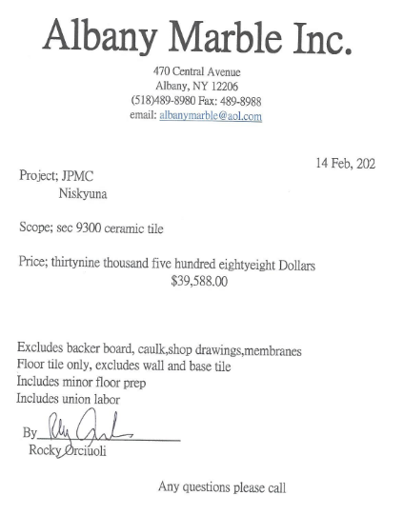
Proposals Workshop Simple Example
Company Name
Address
Phone Number
Email
Price
Contact

Slide 17
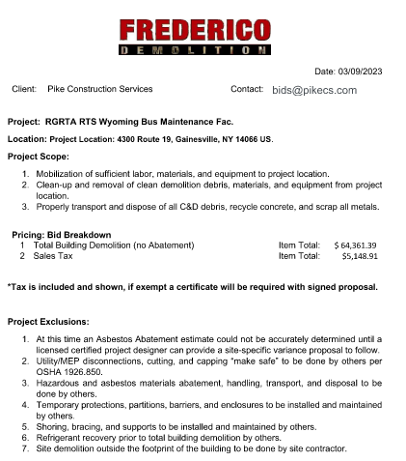
Proposals Workshop – Detailed Example
Company Name
Contact Name; email & phone number
Bid Amount

Slide 18
Post Bid Follow Up
Call and ask for a descope meeting – with everyone you bid – not just the low bidder

Slide 19
Building Long Term Relationships
Communication / Stay In Touch / Follow Up
Listen / Open Minded
Candor
Respect
Humility
Set Goals
Exceed Expectations
Trust

Slide 20
Working with Pike
Prequals
Bidder Lists
Insurances
Put Requirements On Proposals
Commercial Brokers
Payment Methods – Put Requirements On Proposals
Textura Or Similar Payment System Costs
Upcoming Work

Slide 21
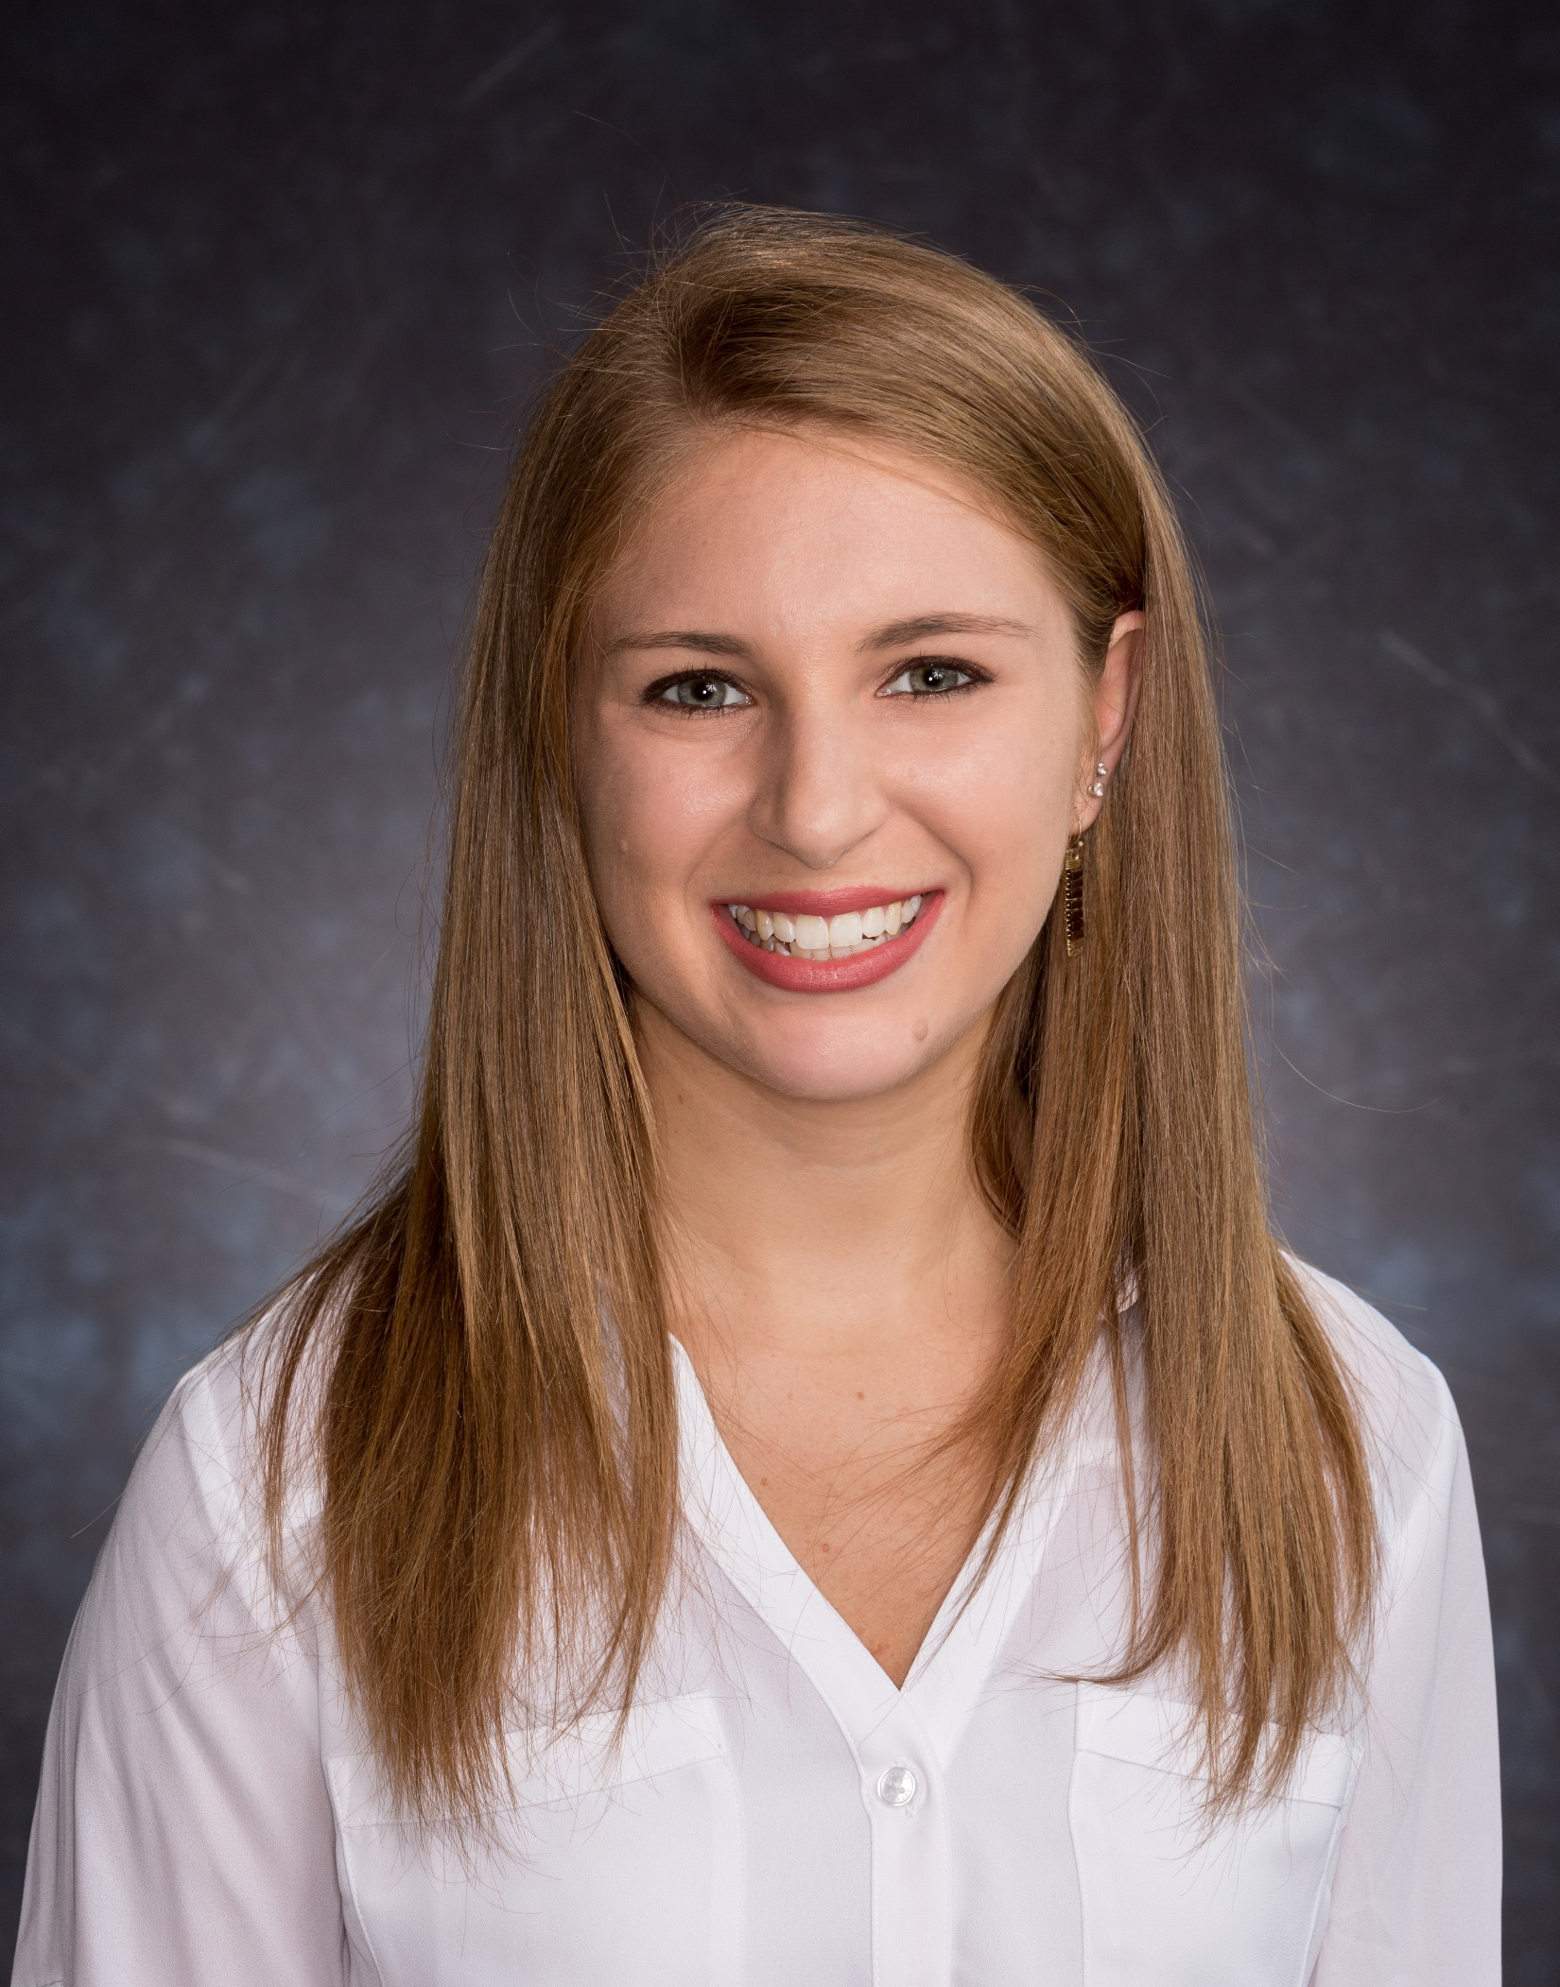
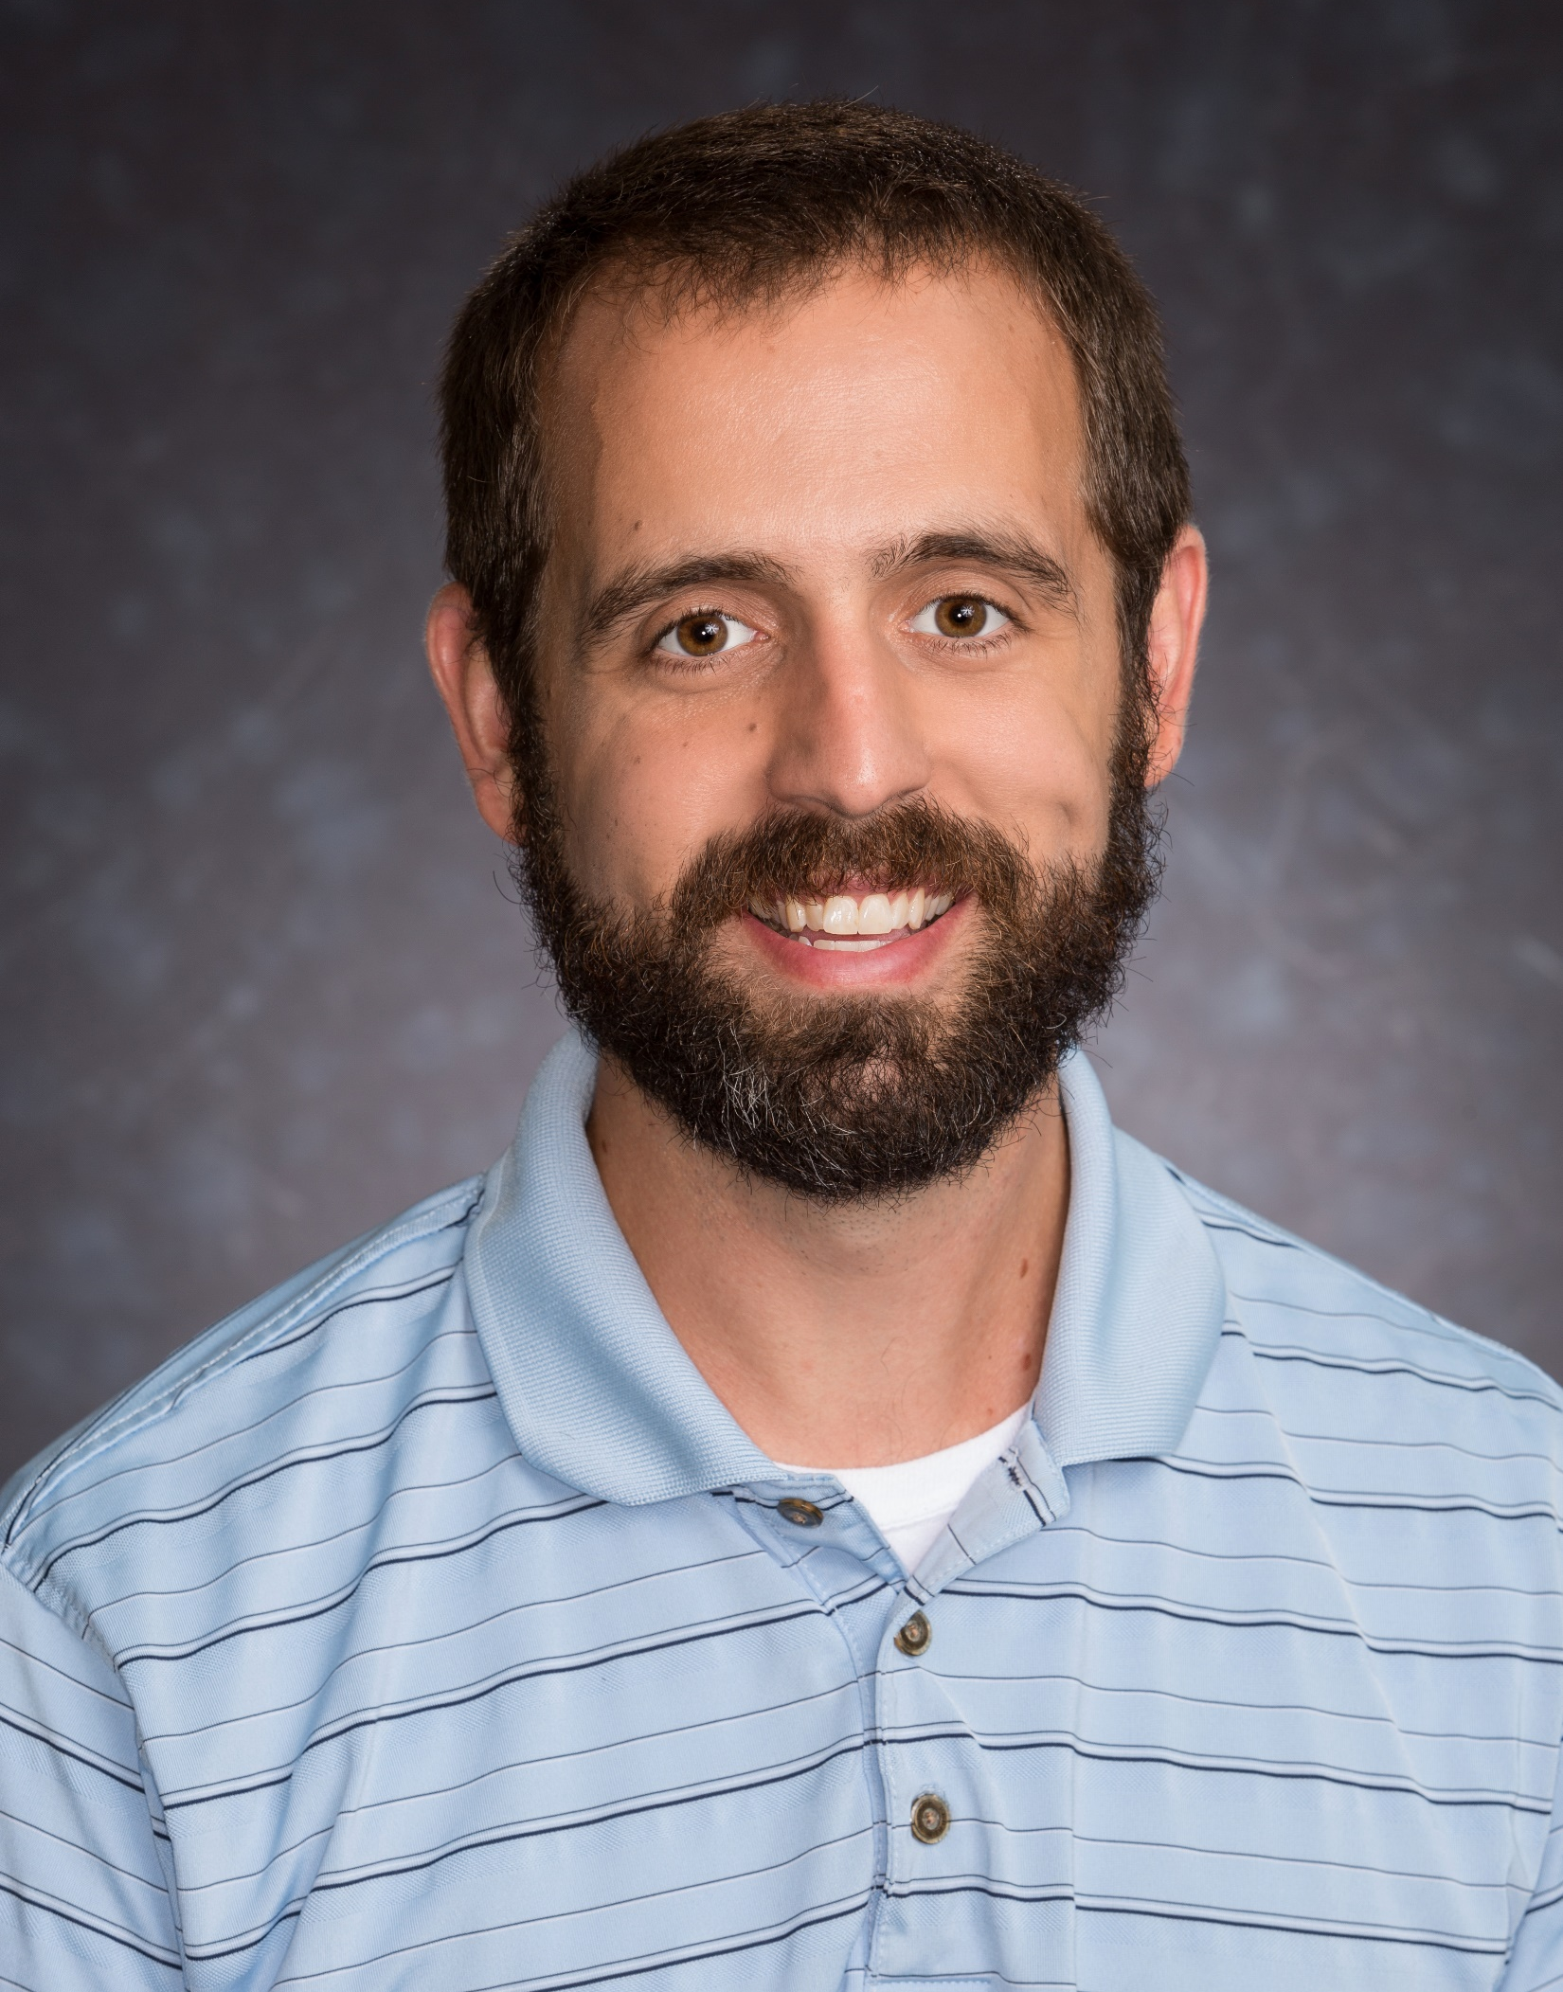
Questions & Answers
Jenna Abato
Bill Rutan
Senior Estimator
Senior Estimator
585-487-7226
abatj@pikecs.com
585-241-0541
rutab@pikecs.com
Pike Construction Services Website - pikecs.com

